Slide 1
Statistics for Data Science Project
Team Members:
Gaurav J
Sai Manoj
Gitika Jain
Guruprasad N Bamane

Slide 2
Abstract
Our goal as a team was to perform some analysis on the female participation in sports. How many athletes, sports, and nations are there? Where do most athletes come from? Who wins medals? What are the characteristics of the athletes who win medals? And so on.
So, we decided to look at the Olympic games data as it has been held for over 100 years and is well recorded. This allowed us to shed light on major progress in the participation of women insights in Olympics through various analysis on the data such as correlations, numerical patterns, verification of hypotheses etc.

Slide 3
Introduction to Dataset
The dataset contains 271116 rows and 15 columns. Each row corresponds to an individual athlete competing in an individual Olympic event (athlete-events). The columns are:
a) ID - Unique number for each athlete
b) Name - Athlete's name
c) Sex - M or F (Categorical – nominal or binary)
d) Age – Integer (Discrete)
e) Height - In centimetres (Discrete)
f) Weight - In kilograms (Continuous)
g) Team - Team name (Categorical, nominal)
h) NOC - National Olympic Committee 3-letter code
i) Games - Year and season
j) Year – Integer (Discrete)
k) Season - Summer or Winter (Categorical, binary)
l) City - Host city
m) Sport - Sport
n) Event - Event
o) Medal - Gold, Silver, Bronze, or NA
- Source: Kaggle.com

Slide 4
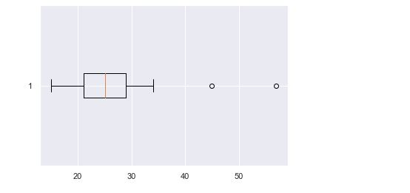
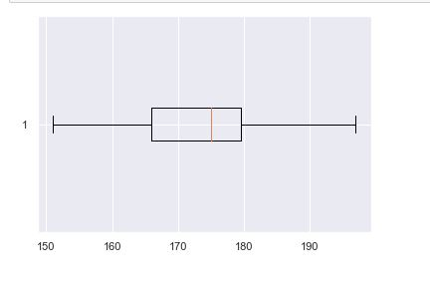
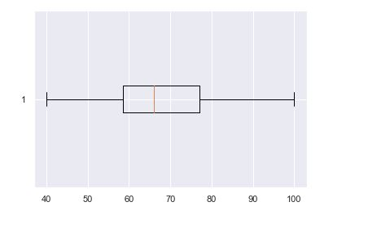
Data Cleaning
Firstly, we removed duplicate rows if any were present
Then, we filled out the missing values if any were present
Then we plot boxplots to analyse the spread of age, height and weight and to check for potential outliers
1. Age 2. Height 3. Weight

Slide 5
Exploratory Data Analysis
Exploratory Data Analysis refers to the critical process of performing initial investigations on data so as to discover patterns, to spot anomalies, to test hypothesis and to check assumptions with the help of summary statistics and graphical representations.
We compare the number of events held for male and female participants.To do this we have to plot a grouped bar chart.
Next, we need to plot a graph to depict the top 5 countries with highest number of female contestants by plotting a bar chart.
Next, we plot histograms to depict the ideal characteristics of the women who can win medals.

Slide 6
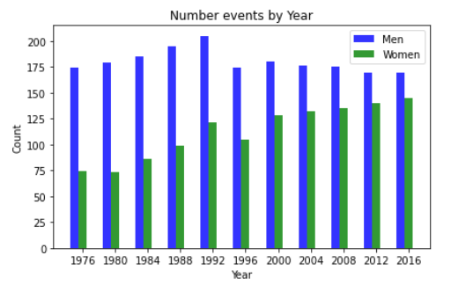
Grouped Bar Chart
Grouped bar charts are Bar charts in which multiple sets of data items are compared, with a single color used to denote a specific series across all sets.
From the plot, the blue and the green bar represents the number of events held for men and women respectively.
The number of events being held for women increased in a gradual manner except for a drop in the year 1996.

Slide 7
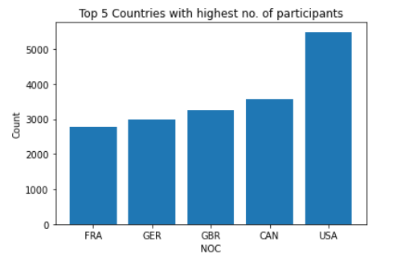
Bar Chart
A diagram in which the numerical values of variables are represented by the height or length of lines or rectangles of equal width.
From the bar chart we can see that the highest number of female participants come from The USA.

Slide 8
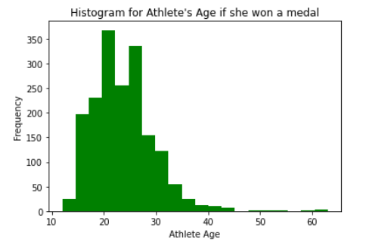
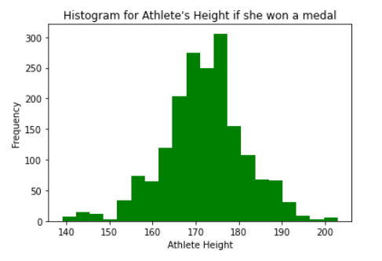
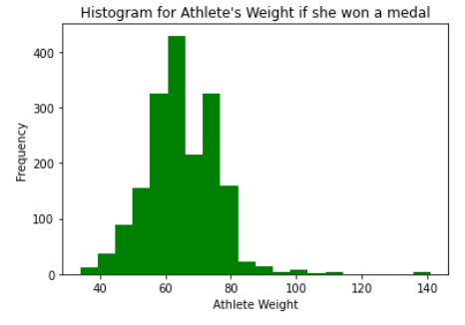
Histogram
A diagram consisting of rectangles whose area is proportional to the frequency of a variable and whose width is equal to the class interval.

Slide 9
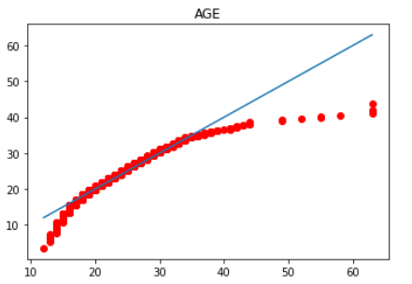
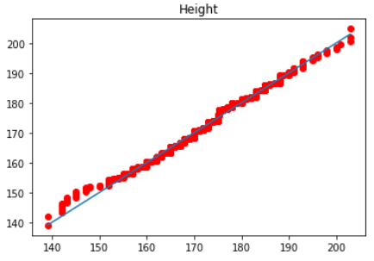
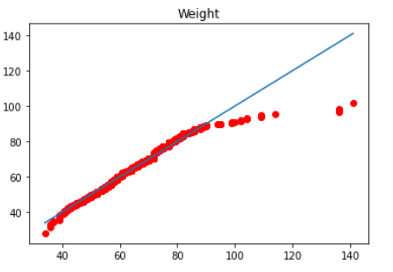
Normal Probability Plot
The normal probability plot is a graphical technique for assessing whether or not a data set is approximately normally distributed. The data are plotted against a theoretical normal distribution in such a way that the points should form an approximate straight line.
We plot normal probability plots for age, height and weight to check if the data is normally distributed.

Slide 10
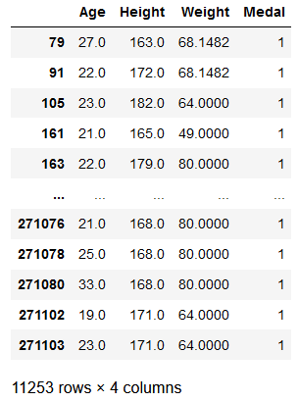
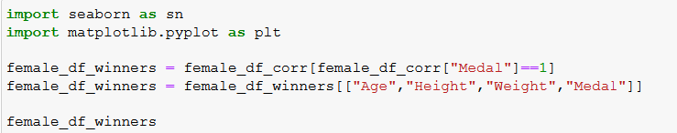
Categorical Data Handling
The medals column in our data set is of categorical type.
We make use of binomial distribution.
If a participant wins a medal we take the value as 1 else 0.

Slide 11
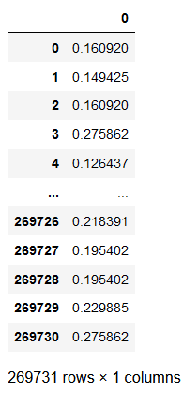
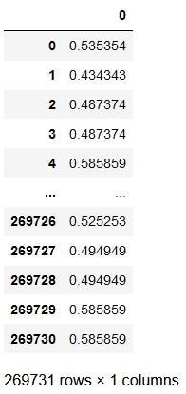
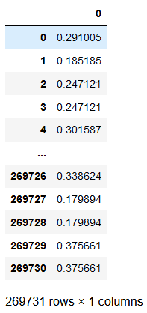
Normalization
Normalization is a technique often applied as part of data preparation for machine learning. The point of normalization is to change the observations so that they can be described as a normal distribution.
“Normalizing” a vector most often means dividing by a norm of the vector. It also often refers to rescaling by the minimum and range of the vector, to make all the elements lie between 0 and 1 thus bringing all the values of numeric columns in the dataset to a common scale.
1. Age 2. Height 3. Weight

Slide 12
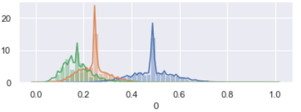
Normalization (cntd.)

Slide 13
Hypothesis Testing
Hypothesis testing is an act in statistics whereby an analyst tests an assumption regarding a population parameter. The methodology employed by the analyst depends on the nature of the data used and the reason for the analysis.
We have assumed our hypothesis test from something like a case study,Many times, in the news or media we have seen reports like, for example:“The Russian female team have prepared strong for upcoming olympic games.The mean age of the squad is just 21, they claim that as that average age of Olympic medallists in every Olympic event over the years have been less than 23. So, the Russians are the favourites”
So now we test this claim:
Ho: u<=23 Ha: u>23
here u₀=23

Slide 14
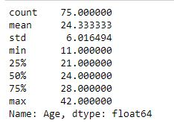
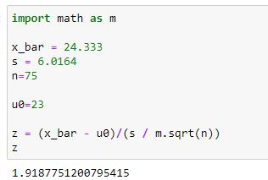
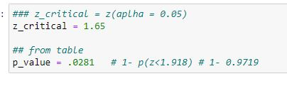
Hypothesis Testing (cntd.)

Slide 15
Hypothesis Testing(cntd.)
From Standard Normal Probabilities Table
we have to find: (Upper tail test)
Therefore, as P-value<= α
So, we reject Ho,
We conclude that we have evidence against u<=23 (for winning female participants),
therefore u>23.

Slide 16
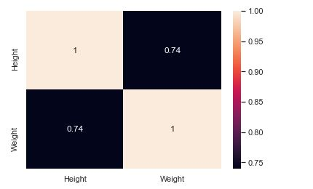
Correlation Between Two Variables
Correlation is a statistical measure that expresses the extent to which two variables are linearly related (meaning they change together at a constant rate).
We plot a correlation matrix using age, height and weight as the parameters.
Since, the correlation coefficient for height and weight is more than 0.7, we can infer that height and weight are positively correlated

Slide 17
Result
We conclude the number of events being held for women have been increasing gradually over the years.
We found out the top 5 countries with highest number of female participants.
Irrespective of the events, we have found out the ideal age, height and weight of a woman to win a medal.
We have conducted a hypothesis regarding the mean age of a woman to win a medal.
We also found out that the height and weight of an athlete are positively correlated.

Slide 18
Thank You.

